Slide 1

Real Time Pokémon Statistic Classification
Wesley STevens

Slide 2


MOtivation
Pokemon Battles
Catching them all

Slide 3
Problem
Determining stats for wild Pokémon is time consuming & Difficult

Slide 4
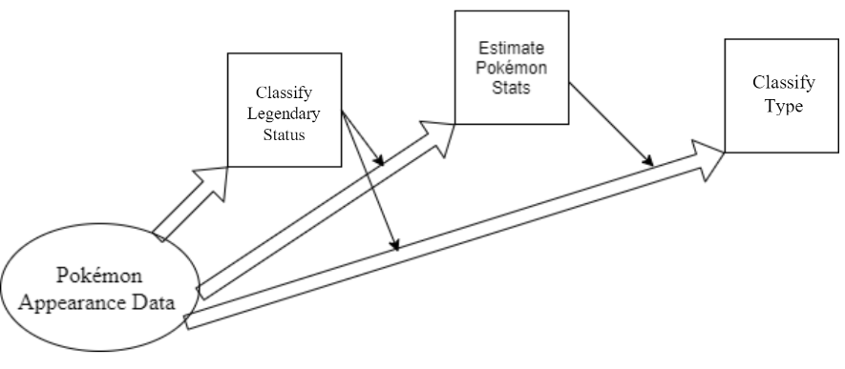
Solution
Replace the Pokédex scanner by Making a 3-fold Data Mining Pipeline to use visual attributes of a Pokémon to predict its hidden statistics

Slide 5
The Data
Can be found on Kaggle
Each statistic for each Pokémon can be modeled by a gaussian distribution and is between 1 and 255
Attributes of interest
Type – Categorical 18 Categories. 1 or 2 Types allowed
HP - Float
Attack - Float
Defense - Float
Speed - Float
IsLegendary – Boolean
Visual Attributes
Color – Categorical
Body Style – Categorical
Height - Float
Weight - Float

Slide 6
Data Preprocessing
Dropped 2 columns that were mostly NANs
Dropped Identification Columns (ID, Name, Number, etc)
Normalized continuous attributes
One-hot encoded nominal attributes
Filled Type_2 with Type_1 values if NAN

Slide 7
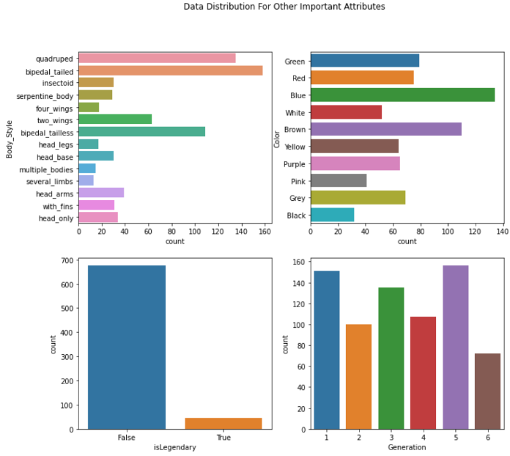

Slide 8
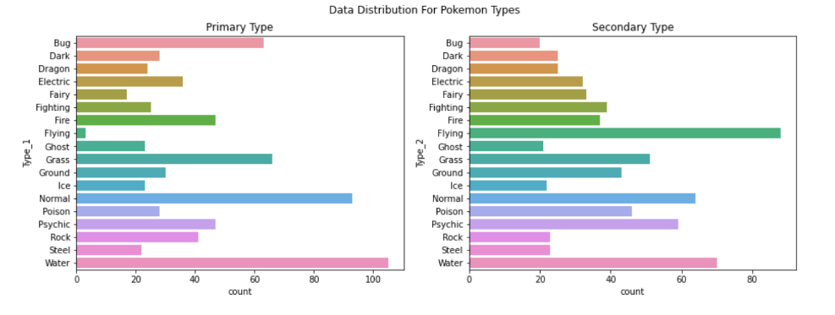

Slide 9
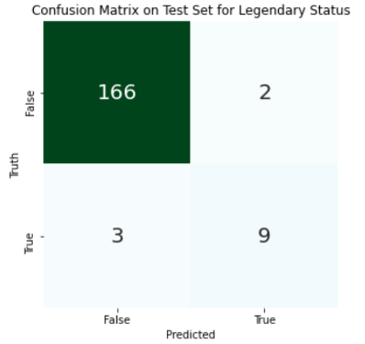
Legendary Status Classification
Best performing model was XGBoost
Metric | Score
Accuracy | 97.2%
Precision | 90%
Recall | 86.9%
F1 Score | 88.4%

Slide 10
Base Statistics Regression
Comparison of regression methods using MSE scoring metric
7-fold cross validation
Linear regression works the best for most of them
 | HP | Speed | Attack | Defense | Sp Attack | Sp Defense
XGBoost | 0.007582 | 0.029 | 0.02118 | 0.014497 | 0.03314 | 0.014675
Linear Regression | 0.007038 | 0.025981 | 0.023484 | 0.012285 | 0.02905 | 0.014259
SVM Regression | 0.007597 | 0.024273 | 0.024655 | 0.012877 | 0.031679 | 0.014614

Slide 11
Pokémon Type Classification
SVM performed the best by far
7-fold cross validation
Used Average Precision, Recall, & F1 Score for multiclass classification
Primary Type | Precision | Recall | F1 Score
Average | 88.8% | 87.9% | 87.3%
Weighted Average | 83.3% | 85.0% | 83.4%
Secondary Type | Precision | Recall | F1 Score
Average | 86.8% | 84.0% | 84.8%
Weighted Average | 82.1% | 83.3% | 82.2%

Slide 12


Temporal Complexity Comparison
Pokédex
AI Pipeline
5.5 Seconds
0.13 Seconds

Slide 13
Conclusion
We’ve successfully been able to predict all aspects of a new Pokémon just based on its appearance at 83% - 97% accuracy
Pokémon battle enthusiasts will be able to find the best Pokémon faster
Pokémon cataloguers will be able to identify rough statistics of new Pokémon even if they run away

Slide 14
Thank you

